Slide 1

Employee Management System
Name : BATHULA VENU GOPAL
Batch NO : 419

Slide 2
About me
Back ground : I Completed my B.tech from VIT University
    Why I want to learn Data Science:
            I am passionate about analyzing real-world problems through data-driven insights.
                Learning Data Science will help me gain better growth in my career and build strong analytical and technical skills for future opportunities.
Work Experience: My previous experience is from a non-IT background, where I extensively worked with Excel for data handling and reporting

Slide 3
Objective:
The Employee Management System is developed to efficiently manage employee records, departments, roles, and payroll information.
It helps organizations track employee details, monitor performance, and manage work assignments.
The system simulates a mini employee database with interconnected entities like employees, job departments, leaves, payroll, salary bonus, and qualification.
Using SQL, users can extract, transform, and analyze employee data to generate actionable insights, for decision-making.
The system enables tracking of employee performance, departmental productivity, and workforce distribution. Data, gaining valuable business insights.
The project aims to optimize HR workflows, improve resource allocation, and enhance overall organizational effectiveness.

Slide 4
Problem Statement:
The objective of this project is to design and implement an Employee Management System that efficiently stores and manages employee-related data within an organization.
The system needs to track various aspects of employee information, including personal details, job roles, salary structures, qualifications, leave records, and payroll data.
The system should ensure the integrity and consistency of data by using relational tables with appropriate foreign keys and cascading actions.
The system should allow for easy management and querying of employee data, providing insights such as payroll calculation, leave tracking, and department-specific job roles.
The goal is to streamline HR operations, ensuring that all relevant employee data is accessible and accurately updated across different modules.

Slide 5
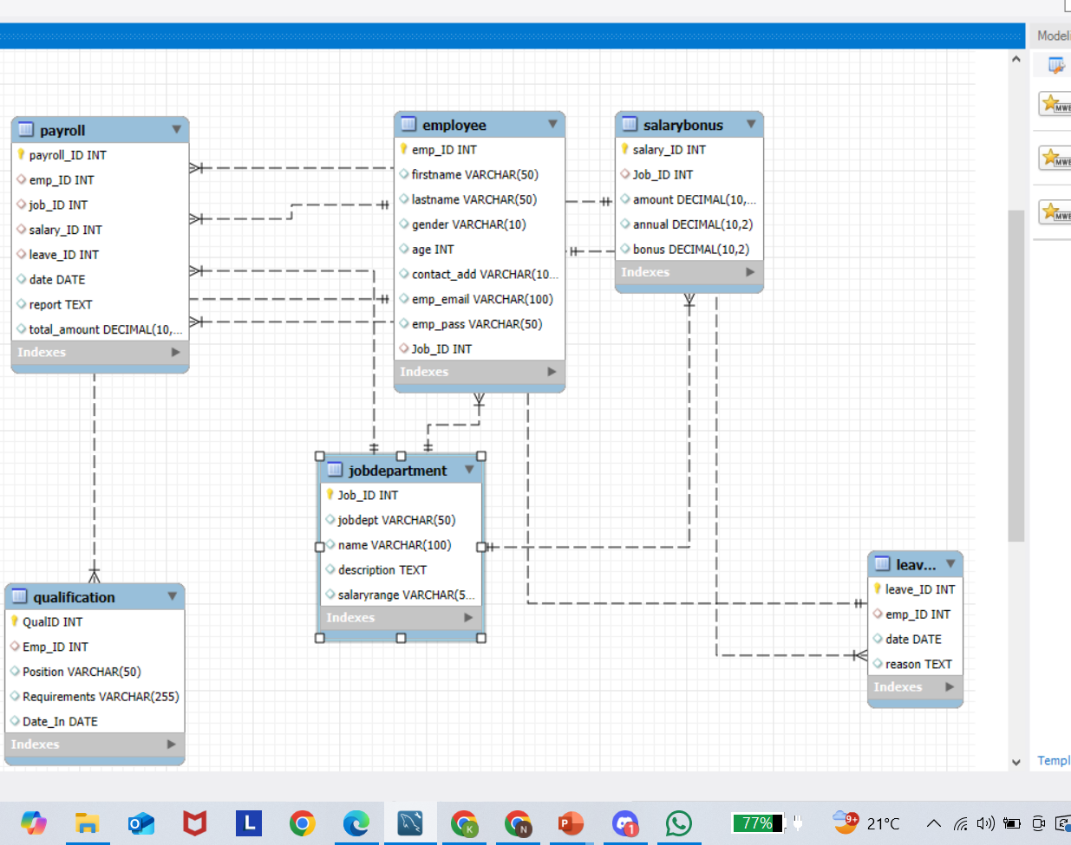
ER Diagram :
The diagram models an HR management system.
employee stores staff details, linking to job department, qualification, and leaves.
job department defines roles and departments.
qualification lists employee qualifications.
leaves records employee leave details.
Salary bonus specifies pay and bonuses for each job.
payroll calculates pay, combining job, salary, and leave data.

Slide 6
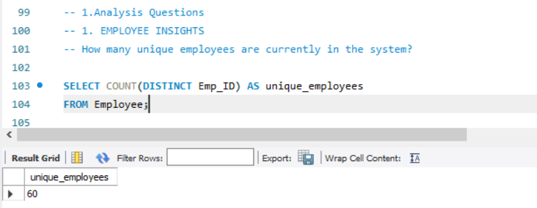
Key Analysis:
1. Employee insights
How many unique employees are currently in the system?
The query counts the number of unique employees in the system using their Emp_ID. The result shows there are 60 unique employees in the database.

Slide 7
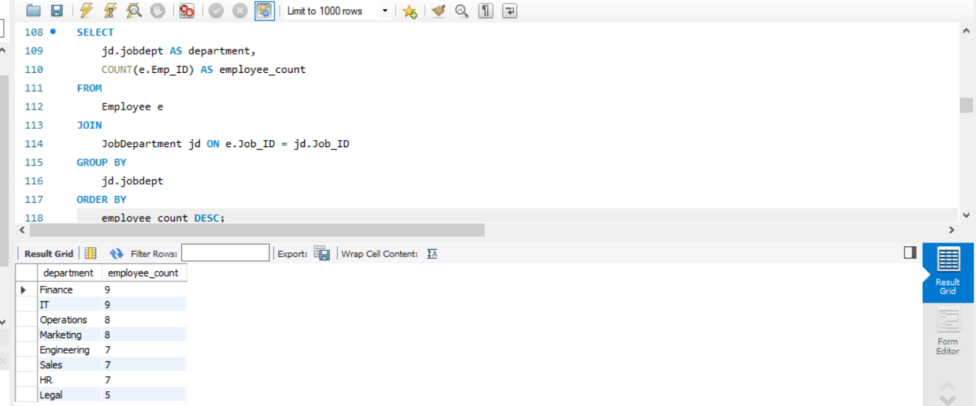
Which departments have the highest number of employees?
This query identifies how many employees work in each department and displays the departments ranked from highest to lowest employee count — helping visualize workforce distribution across departments.
Key insights:
IT and Finance have the highest employee count → 9 employees each
Legal department has the fewest employees → 5 employees

Slide 8
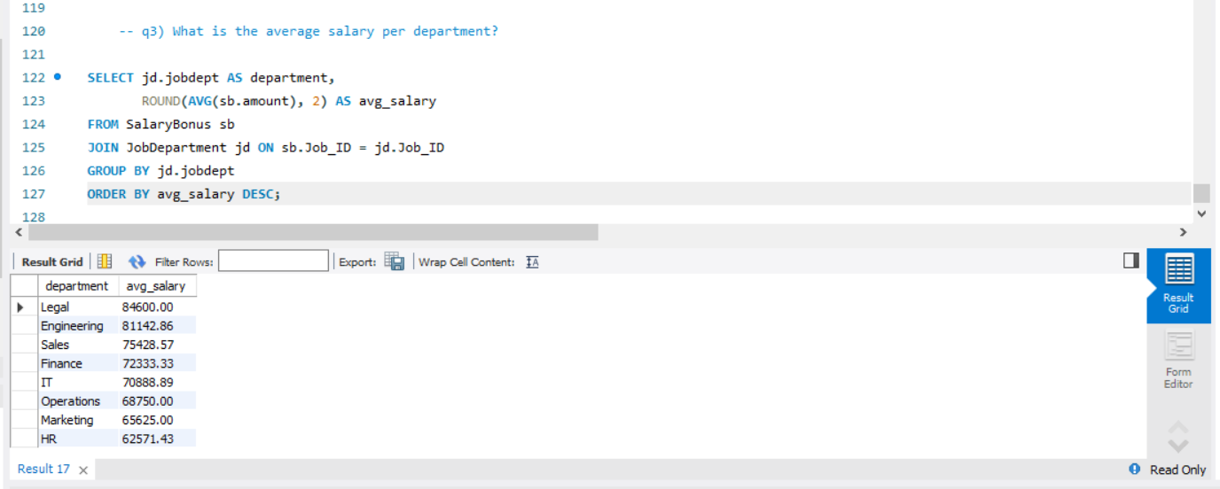
What is the average salary per department?
This query calculates and displays the average salary for each department, ranking them in descending order — showing that the Legal department has the highest average salary, followed by Engineering and Sales.

Slide 9
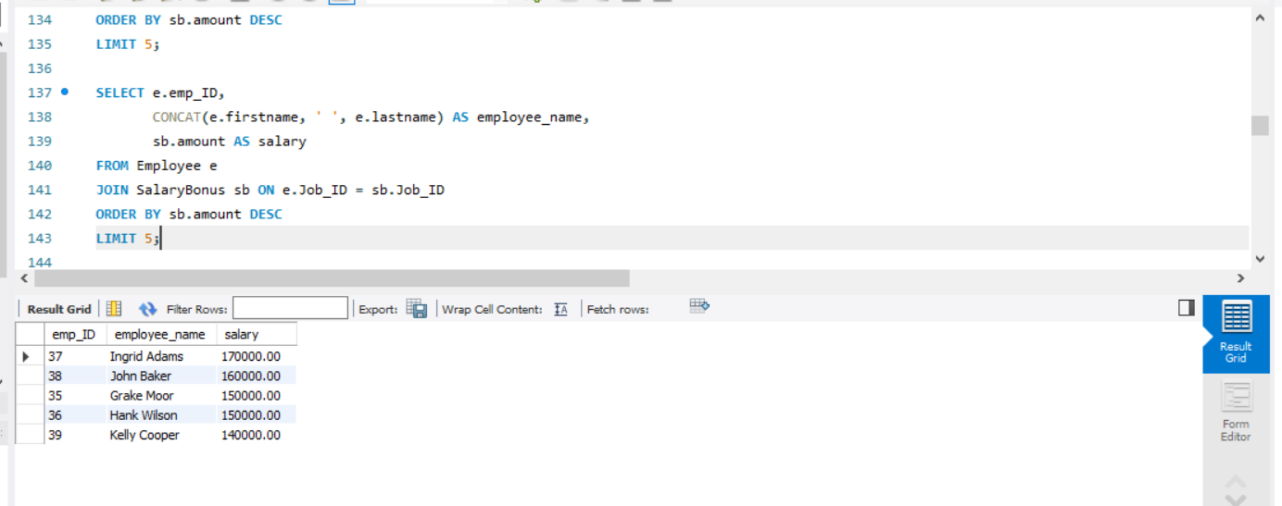
Who are the top 5 highest-paid employees?
This query retrieves the top 5 highest-paid employees, displaying their ID, full name, salary, and bonus — with Ingrid Adams earning the highest salary among them.

Slide 10
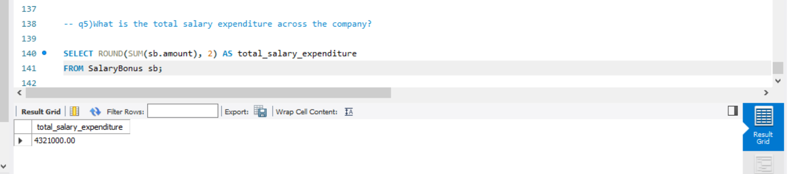
What is the total salary expenditure across the company?
This query calculates the total salary expenditure across all employees from the SalaryBonus table, showing an overall cost of 4,321,000.00.

Slide 11
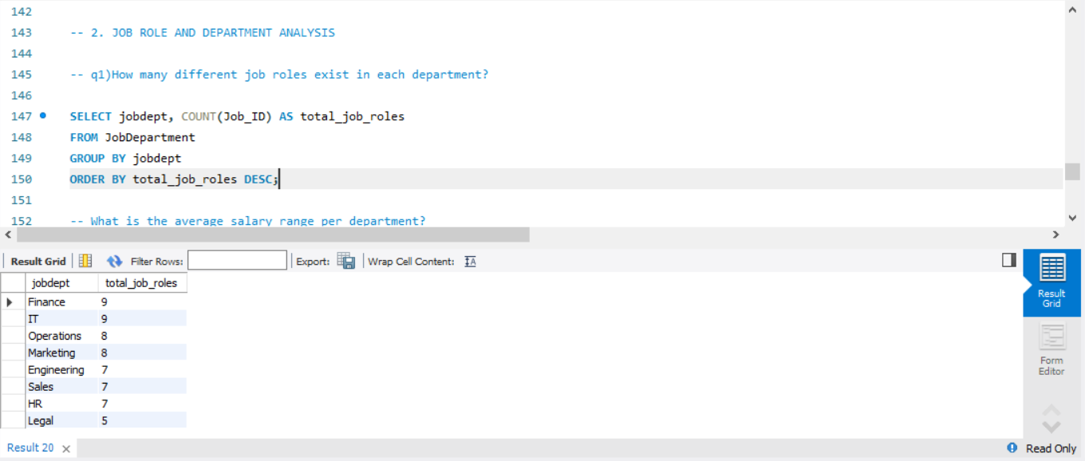
2. JOB ROLE AND DEPARTMENT ANALYSIS
How many different job roles exist in each department?
The query counts the total job roles in each department using the COUNT function.
It groups results by department and sorts them from highest to lowest.
Finance tops the list with the most job roles.

Slide 12
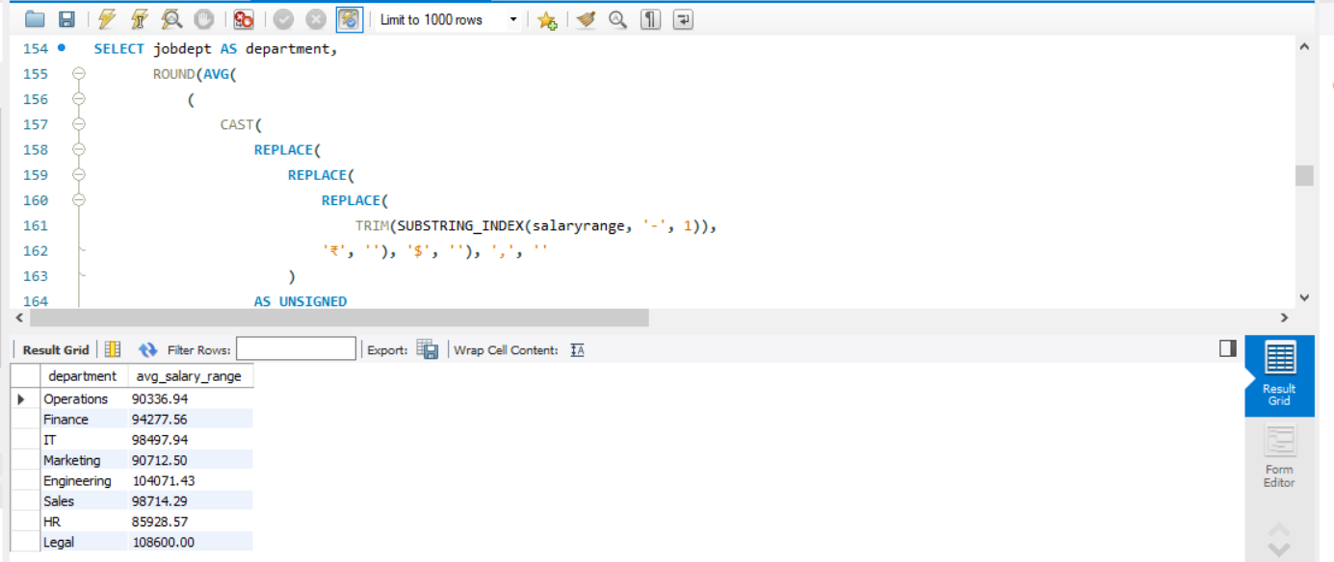
What is the average salary range per department?
The goal of this query is to compute the average salary range for every department based on the salaryrange column in the JobDepartment table.

Slide 13
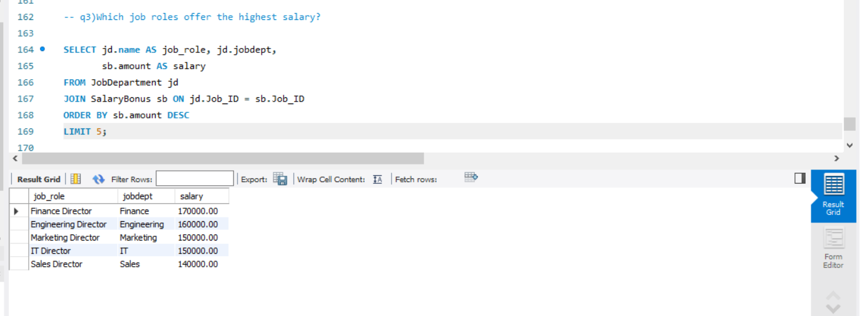
Which job roles offer the highest salary?
The query lists the top 5 highest-paying job roles by joining job and salary tables.
It sorts salaries in descending order to show the highest first.
Finance Director has the highest salary, followed by Engineering and Marketing Directors.

Slide 14

Which departments have the highest total salary allocation?
This query calculates the total salary (including bonuses) for each department by summing the amount from the SalaryBonus table. It groups results by department and displays them in descending order of total salary.

Slide 15
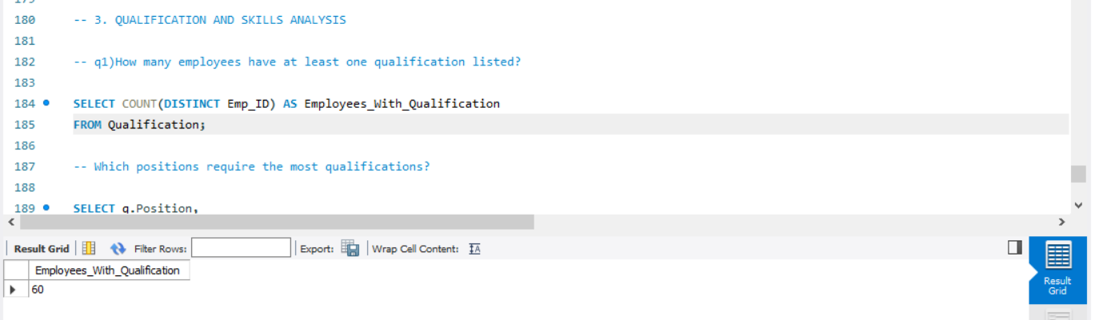
3. QUALIFICATION AND SKILLS ANALYSIS
How many employees have at least one qualification listed?
This query counts the number of unique employees who have qualifications.
It retrieves the total count (60 employees) from the Qualification table.

Slide 16
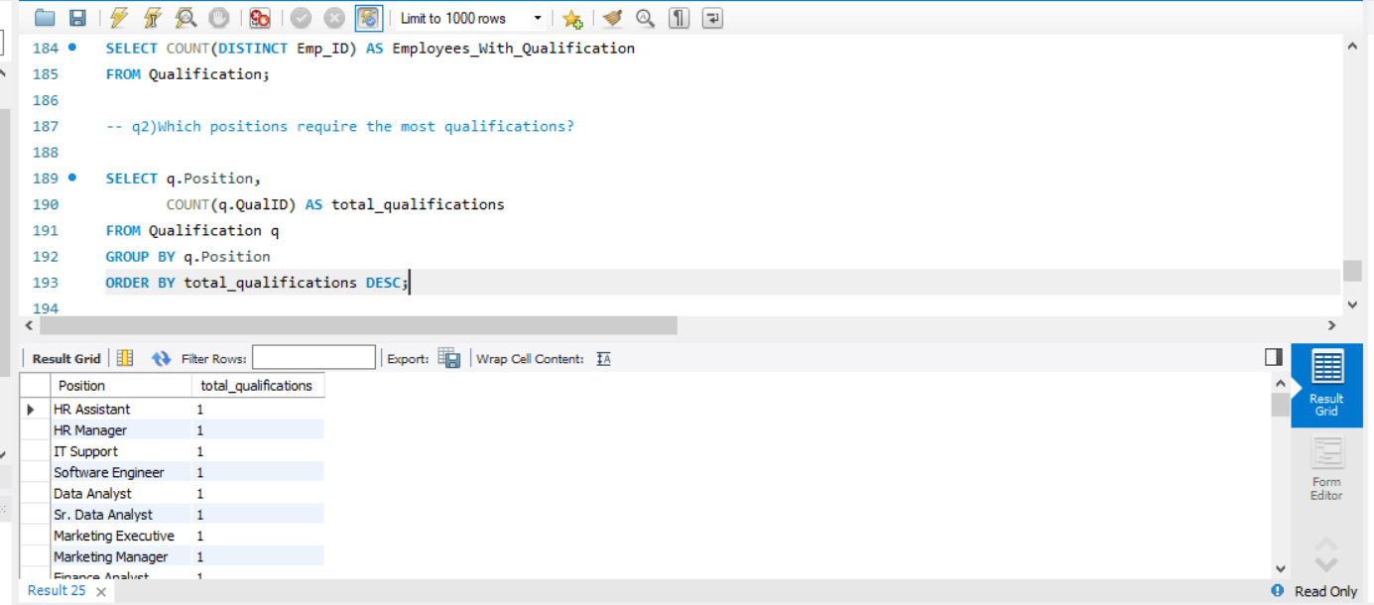
Which positions require the most qualifications
This SQL query counts the number of qualifications for each job position.
It groups the data by position and displays total qualifications in descending order.

Slide 17

Which employees have the highest number of qualifications?
This query retrieves the top 5 employees with the highest number of qualifications.
It joins the Employee and Qualification tables, groups by employee, and orders results by total qualifications in descending order.

Slide 18
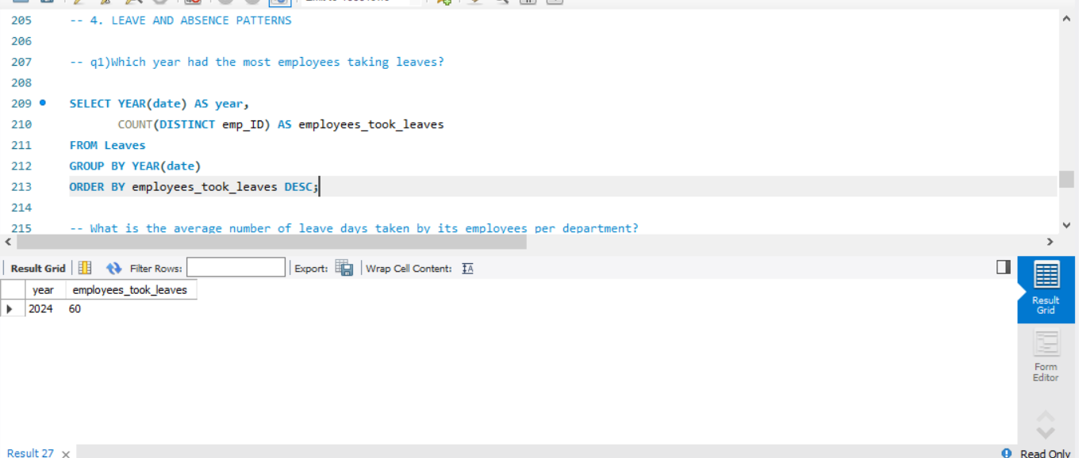
4. LEAVE AND ABSENCE PATTERNS
Which year had the most employees taking leaves?
This query counts how many unique employees took leaves each year.
It groups data by year and shows that 60 employees took leaves in 2024.

Slide 19
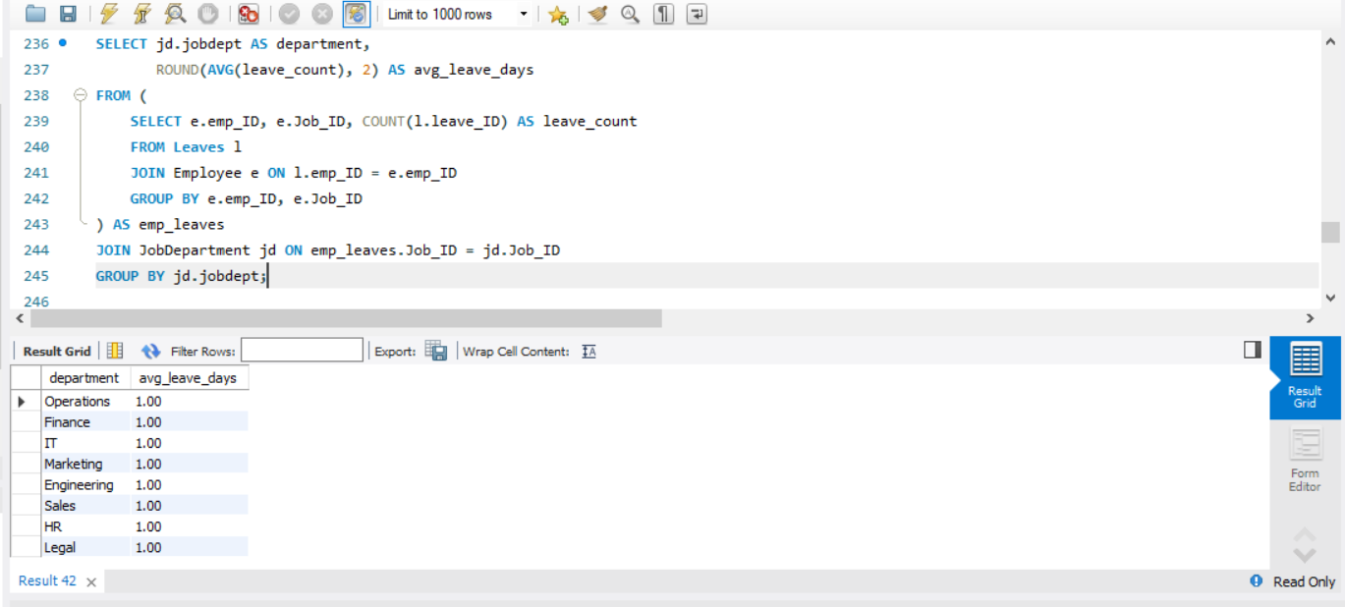
What is the average number of leave days taken by its employees per department?
This query calculates the average number of leave days taken by employees in each department.
It groups results by department and shows that all departments have an average of 1 leave day.

Slide 20
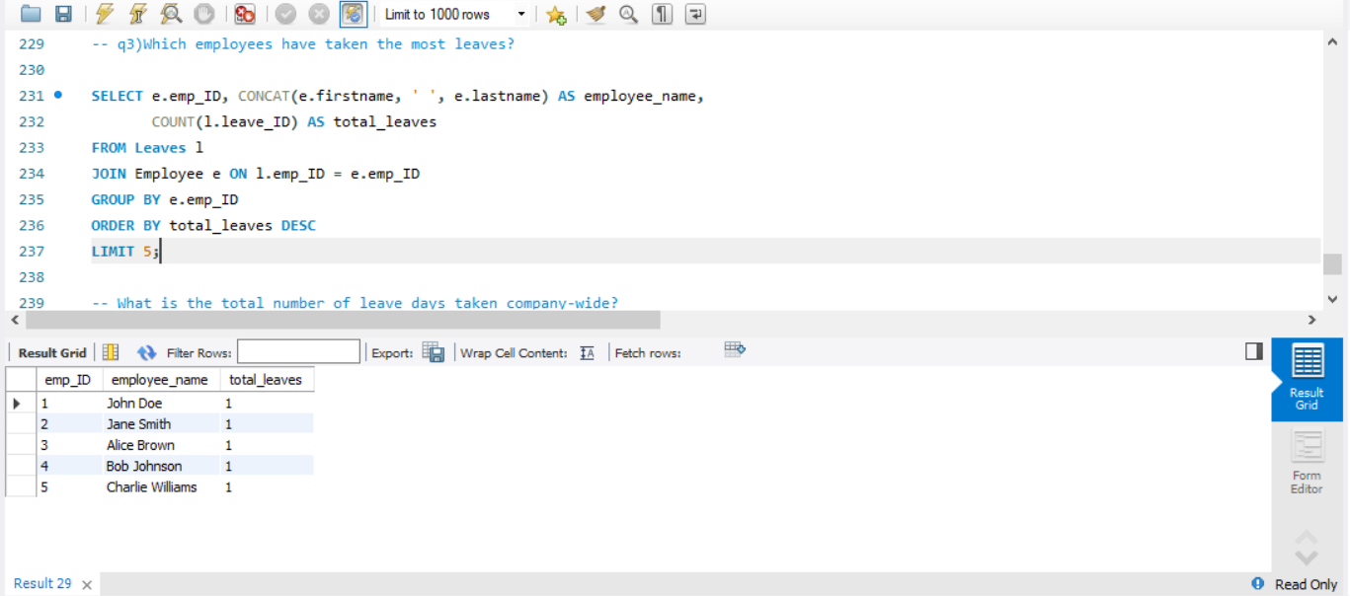
Which employees have taken the most leaves?
This query lists the top 5 employees who took the most leaves.
It joins the Leaves and Employee tables, counts total leaves per employee, and orders them in descending order.

Slide 21
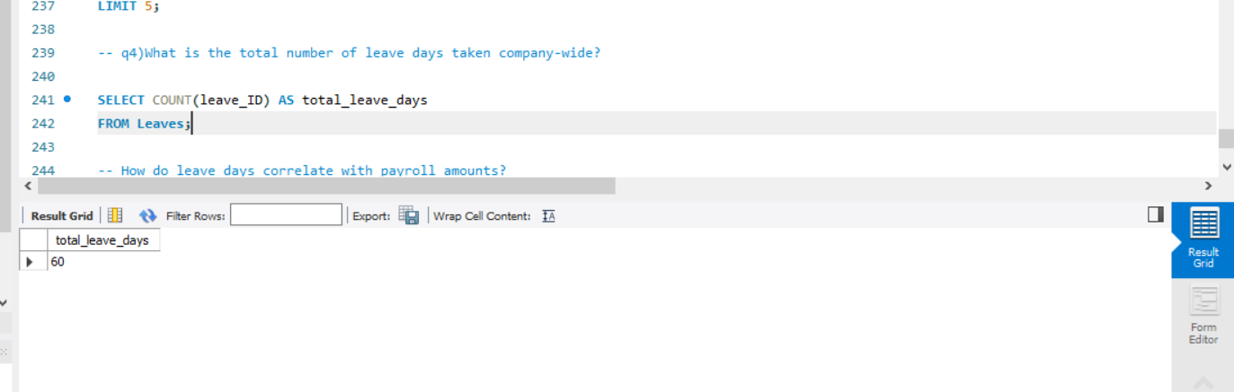
What is the total number of leave days taken company-wide?
This query counts the total number of leave records in the Leaves table.
It shows that employees collectively took 60 leave days.

Slide 22
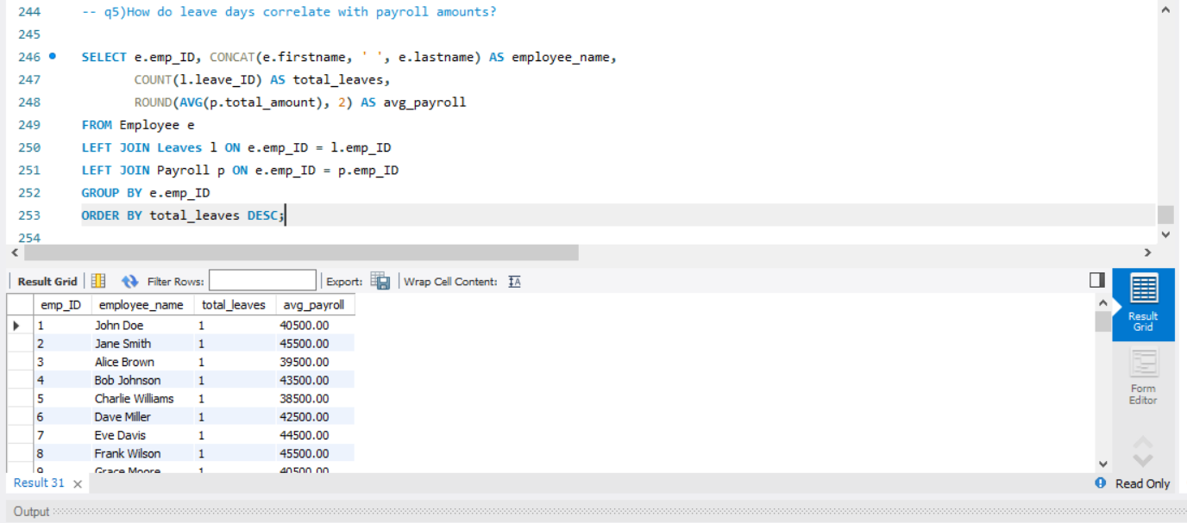
How do leave days correlate with payroll amounts?
This query displays each employee’s total leaves and their average payroll amount.
It joins Employee, Leaves, and Payroll tables, grouping by employee and ordering by total leaves.

Slide 23
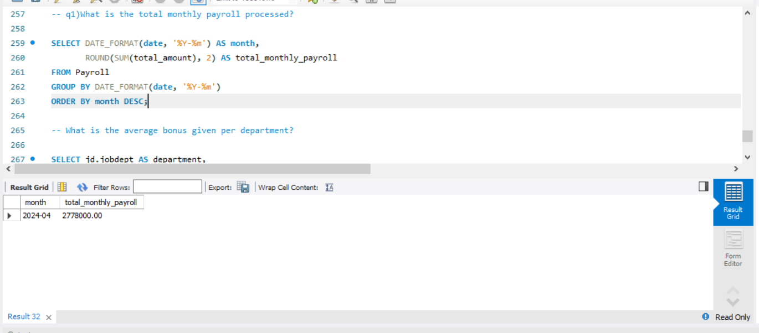
5. PAYROLL AND COMPENSATION ANALYSIS
What is the total monthly payroll processed?
This query calculates the total payroll amount for each month.
It groups payroll data by month and shows that in April 2024, the total payroll was 2,778,000.00.

Slide 24
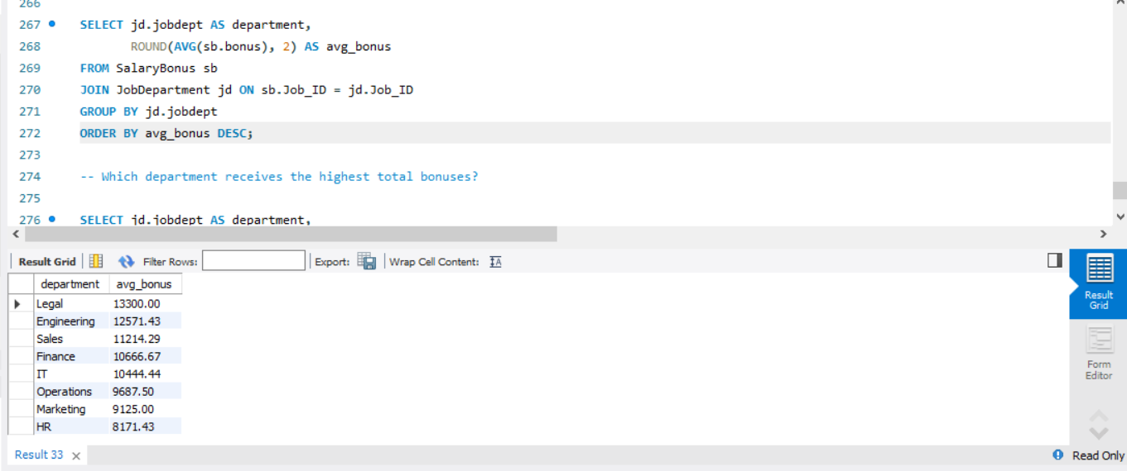
What is the average bonus given per department?
This query calculates the average bonus for each department.
It groups results by department and orders them in descending order of average bonus, with the Legal department having the highest.

Slide 25
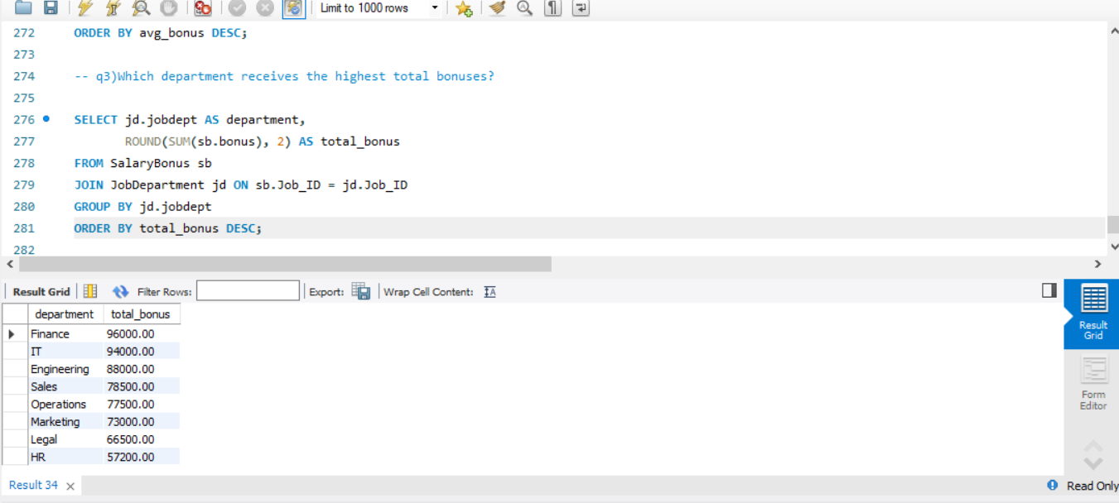
Which department receives the highest total bonuses?
This query calculates the total bonus amount for each department.
It groups data by department and sorts them in descending order, showing Finance with the highest total bonus.

Slide 26
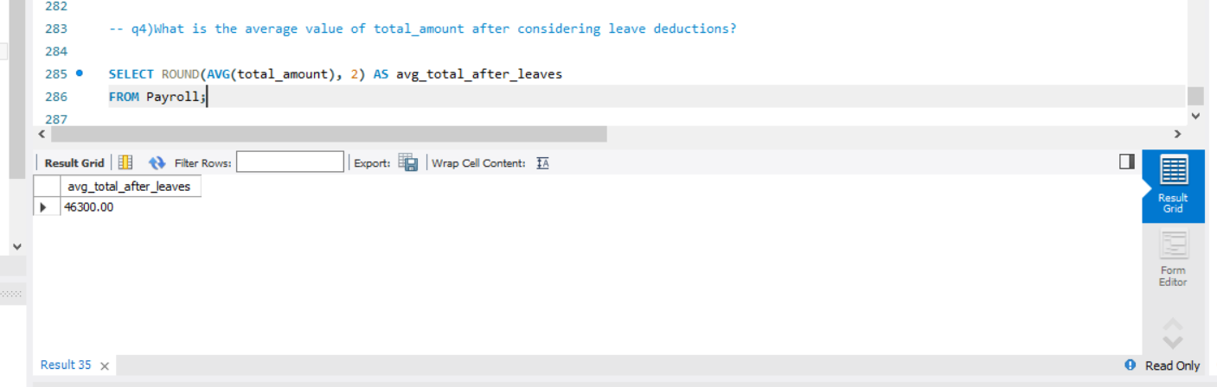
What is the average value of total_amount after considering leave deductions?
This query calculates the average payroll amount after accounting for leaves.
It shows that the average total payroll across all employees is 46,300.00.

Slide 27
Final business insights and recommendations
Departments with more employees may require additional resources and better management oversight.
Highest-paid roles indicate key positions; these employees should be retained and motivated.
Average salaries and total salary expenditures help in budget planning and financial forecasting.
Employees with multiple qualifications can be considered for promotions or critical projects.
Tracking leaves and absence patterns helps in workforce planning and minimizing productivity loss.
Payroll and bonus analysis can optimize compensation strategies and reward performance effectively.
Data-driven insights support HR decisions in recruitment, training, and role allocation.
Monitoring employee trends ensures better operational efficiency and organizational growth.

Slide 28
Conclusion(Key finding overall)
The database efficiently organizes employee, department , payroll, leave, and qualification data.
Salary and bonus analysis revealed key high-paying roles and departments with major expenditures.
Employee qualifications and leave patterns provide insights for training and workforce planning.
Payroll tracking ensures accurate compensation and highlights trends for financial planning.
Data-driven insights support better HR decisions, resource allocation, and employee management.
Overall, the system enables informed decision-making, improves operational efficiency, and enhances organizational performance.

Slide 29
Experience & Challenges
Gained hands-on experience in designing and managing relational databases with multiple tables.
Learned to write complex SQL queries for analysis, aggregation, and joins.
Understood relationships between tables and how foreign keys maintain data integrity.
Faced challenges in query optimization for faster results on large datasets.
Learned to handle data consistency issues while linking payroll, leaves, and employee records.
Improved problem- solving skills and ability to extract actionable insights from raw data.

Slide 30

THANK YOU
BATHULA VENU GOPAL

